Slide 1

Decision Trees
Lecture 5

Slide 2
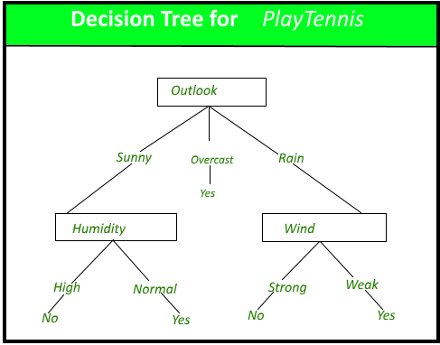
Decision tree induction
Decision tree induction is the learning of decision trees from class-labeled training tuples.
A decision tree is a flowchart-like tree structure, where each internal node (non-leaf node) denotes a test on an attribute, each branch represents an outcome of the test, and each leaf node (or terminal node) holds a class label.
The topmost node in a tree is the root node.
Notes:
הוא נותן לייבל בהתאם לשכניו הקרובים ביותר מתוך הנחה שמי שקרוב אליי כנראה דומה לי.
זה לא אומר בהכרח שמודל מורכב הוא לא טוב, אבל צריך לקחת בחשבון את המורכבות לצד כמה במת הוא תורם לדיוק.

Slide 3
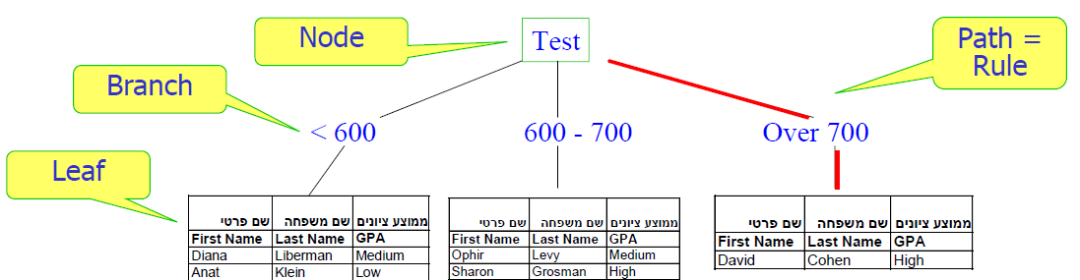
Decision tree structure
Main Components
Nodes - tests of some attribute
Branch - one of possible values for the attribute
Leaves (terminal nodes) - classifications
Path (from the tree root to a leaf) - conjunction of attribute tests
Notes:
הוא נותן לייבל בהתאם לשכניו הקרובים ביותר מתוך הנחה שמי שקרוב אליי כנראה דומה לי.
זה לא אומר בהכרח שמודל מורכב הוא לא טוב, אבל צריך לקחת בחשבון את המורכבות לצד כמה במת הוא תורם לדיוק.

Slide 4
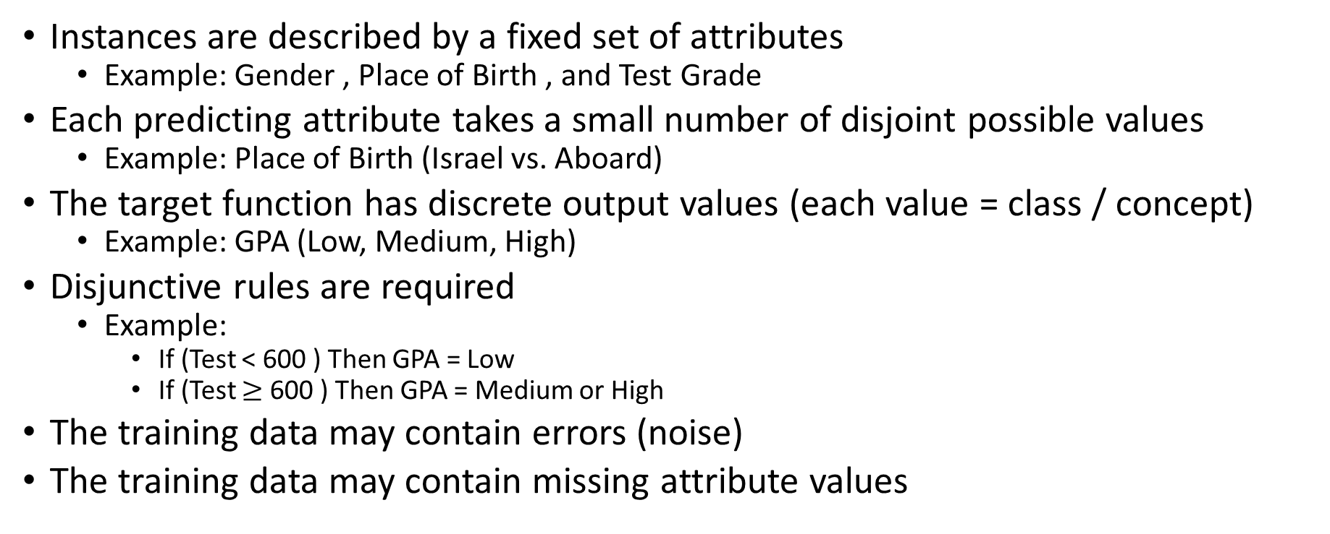
Appropriate Problems + Student Example
Instances are described by a fixed set of attributes
Example: Gender , Place of Birth , and Test Grade
Each predicting attribute takes a small number of disjoint possible values
Example: Place of Birth (Israel vs. Aboard)
The target function has discrete output values (each value = class / concept)
Example: GPA (Low, Medium, High)
Disjunctive rules are required
Example:
If (Test < 600 ) Then GPA = Low
If (Test $≥$ 600 ) Then GPA = Medium or High
The training data may contain errors (noise)
The training data may contain missing attribute values
Notes:
הוא נותן לייבל בהתאם לשכניו הקרובים ביותר מתוך הנחה שמי שקרוב אליי כנראה דומה לי.
זה לא אומר בהכרח שמודל מורכב הוא לא טוב, אבל צריך לקחת בחשבון את המורכבות לצד כמה במת הוא תורם לדיוק.

Slide 5
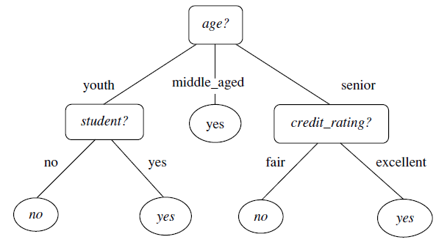
Decision tree induction
A decision tree for the concept buys computer, indicating whether an AllElectronics customer is likely to purchase a computer.
Each internal (non-leaf) node represents a test on an attribute.
Each leaf node represents a class (either buys computer == yes or buys computer == no).
Notes:
Figure 8.2. It represents the concept buys computer, that is, it predicts whether a customer at AllElectronics is likely to purchase a computer. Internal nodes are denoted by rectangles, and leaf nodes are denoted by ovals.

Slide 6
Decision tree induction
A typical decision tree is shown.
It represents the concept buys computer, that is, it predicts whether a customer at AllElectronics is likely to purchase a computer.
Internal nodes are denoted by rectangles, and leaf nodes are denoted by ovals.
Some decision tree algorithms produce only binary trees (where each internal node branches to exactly two other nodes), whereas others can produce non-binary trees.
Notes:
Figure 8.2. It represents the concept buys computer, that is, it predicts whether a customer at AllElectronics is likely to purchase a computer. Internal nodes are denoted by rectangles, and leaf nodes are denoted by ovals.

Slide 7
Building a Decision Tree
There are several algorithms to build a decision tree.
CART-Classification and Regression Trees
ID3-Iterative Dichotomiser 3
C4.5
CHAID-Chi-squared Automatic Interaction Detection
We discuss only CART and ID3 algorithms as they are the ones majorly used.

Slide 8
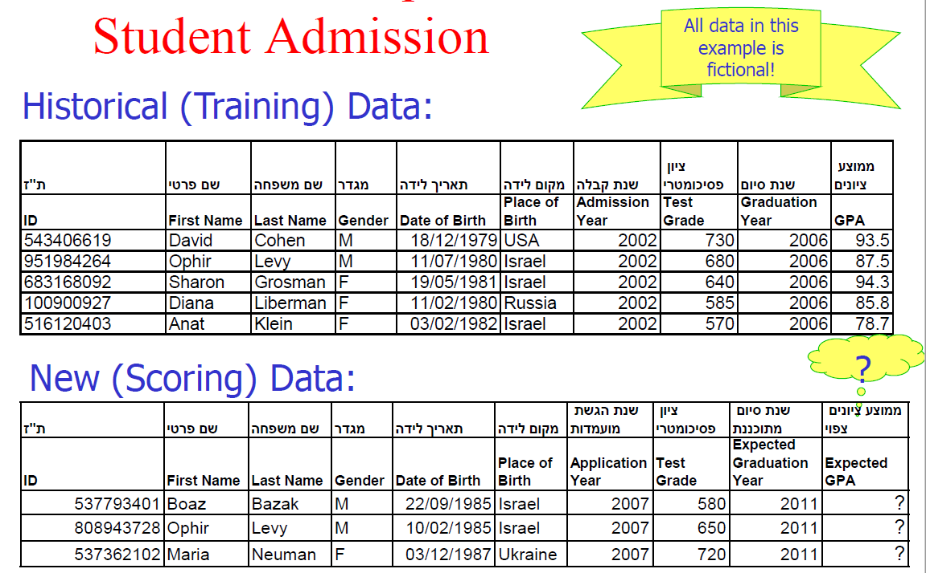
ID3
Notes:
Example

Slide 9
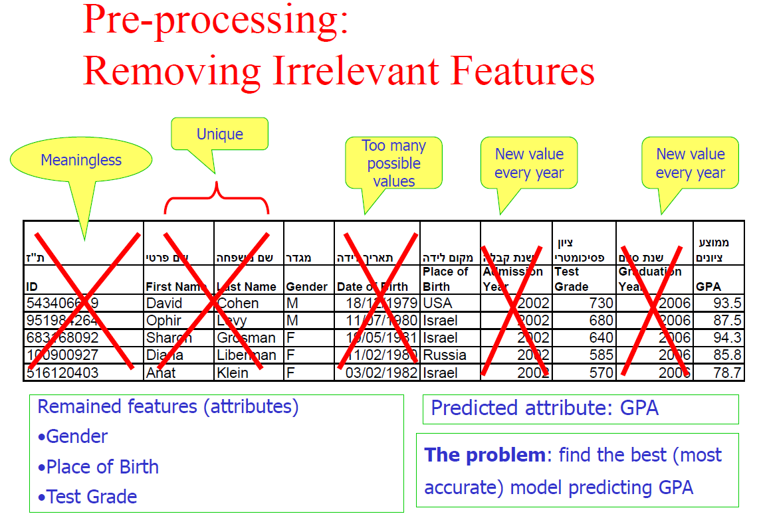
ID3
Notes:
Example

Slide 10
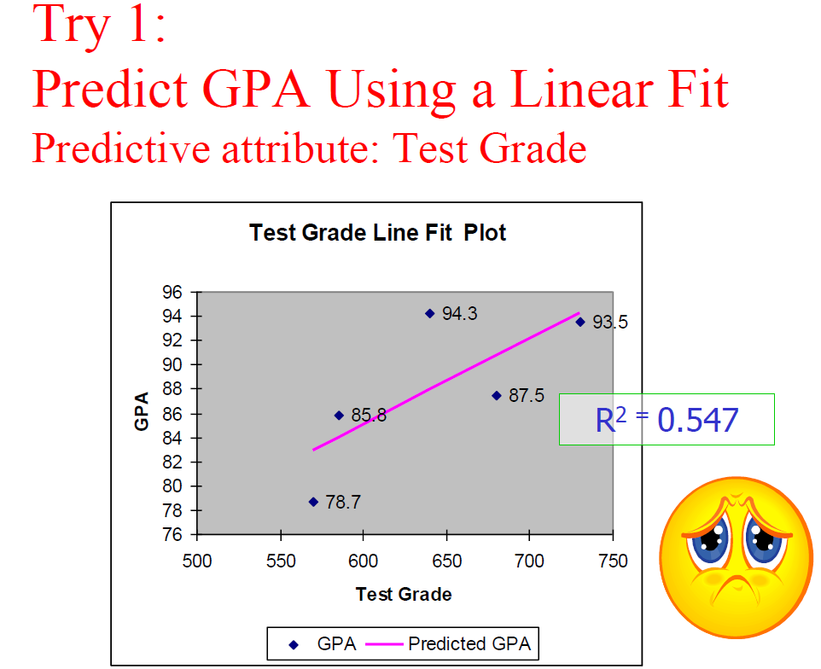
Notes:
R² is a statistic that will give some information about the goodness of fit of a model.^{[citation needed]} In regression, the R² coefficient of determination is a statistical measure of how well the regression predictions approximate the real data points. An R² of 1 indicates that the regression predictions perfectly fit the data.

Slide 11
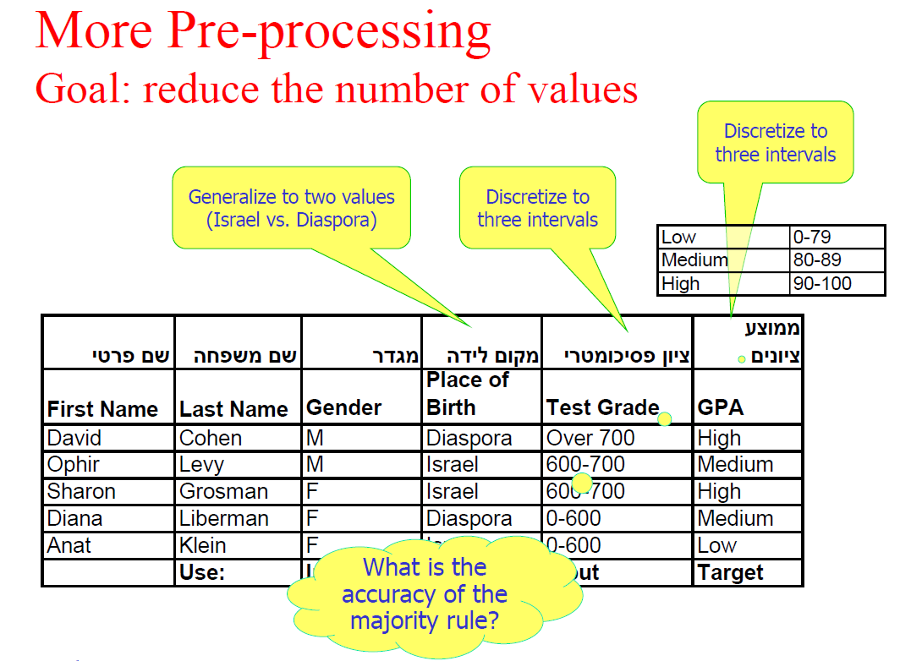
Notes:
Example

Slide 12
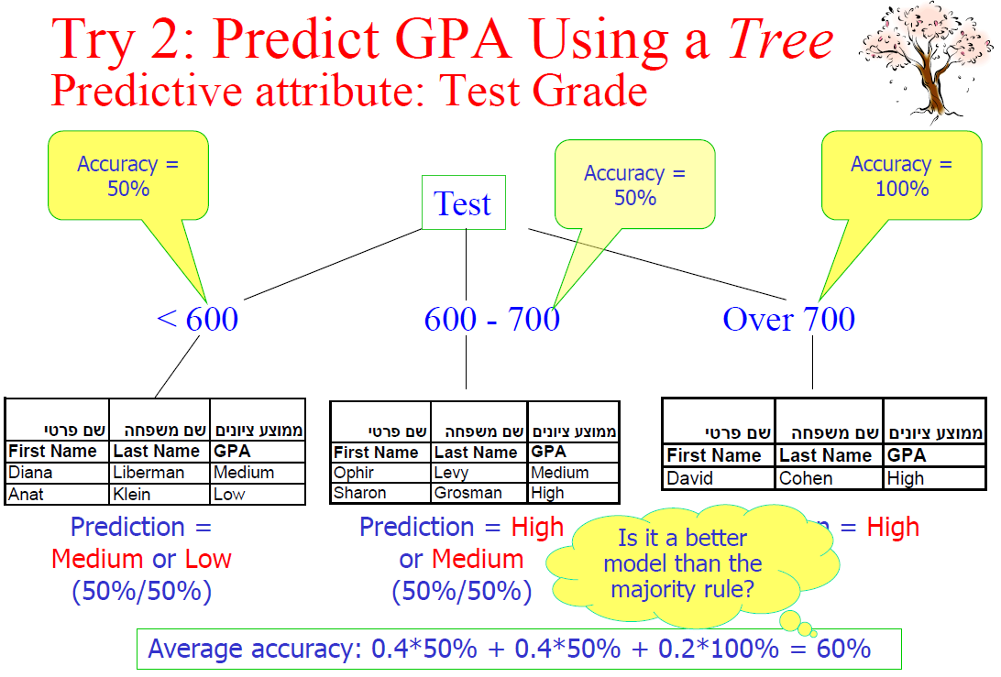
Notes:
0.4 = 2/5 – Diana and Anat (=2) among Diana, Anat, Ophir, Sharon, and David (=5)

Slide 13
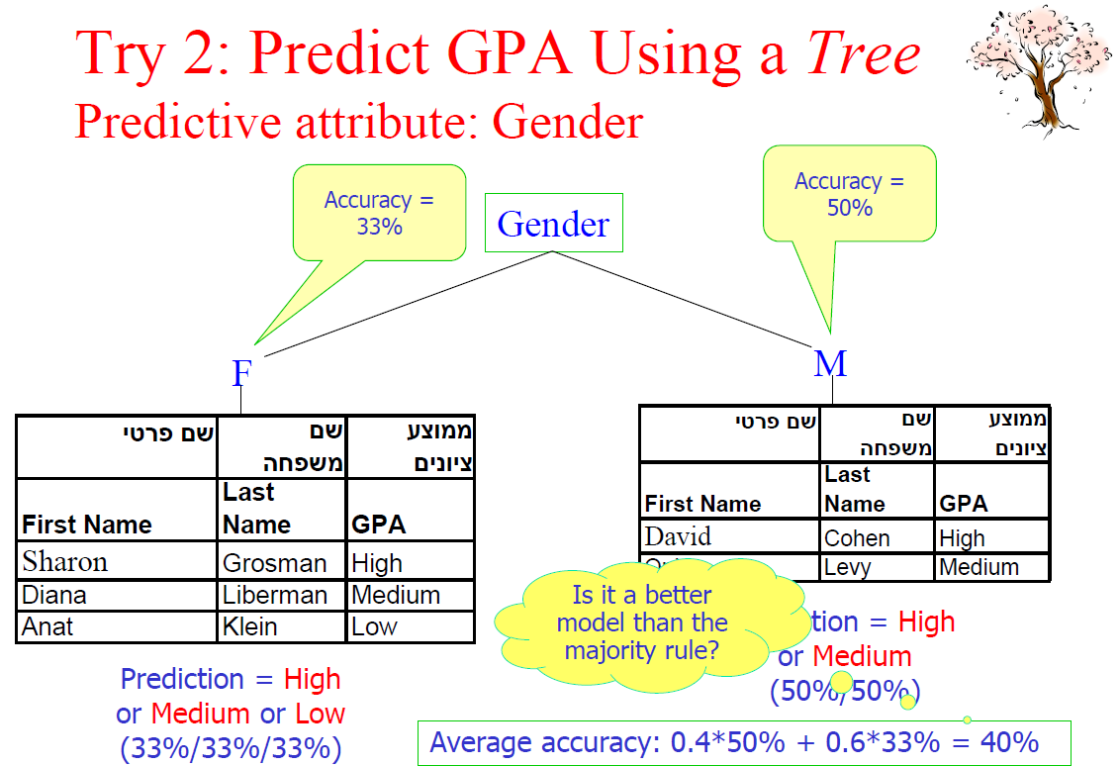
Notes:
Example

Slide 14
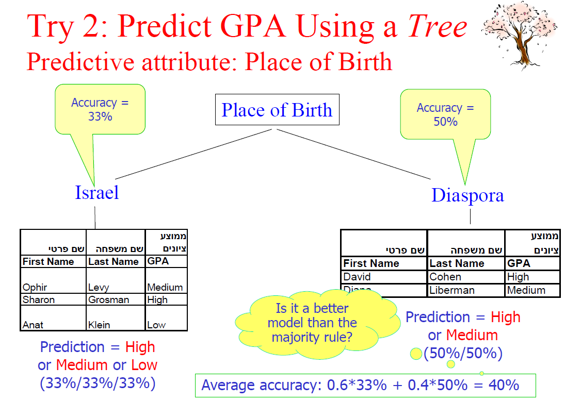
Notes:
Example

Slide 15
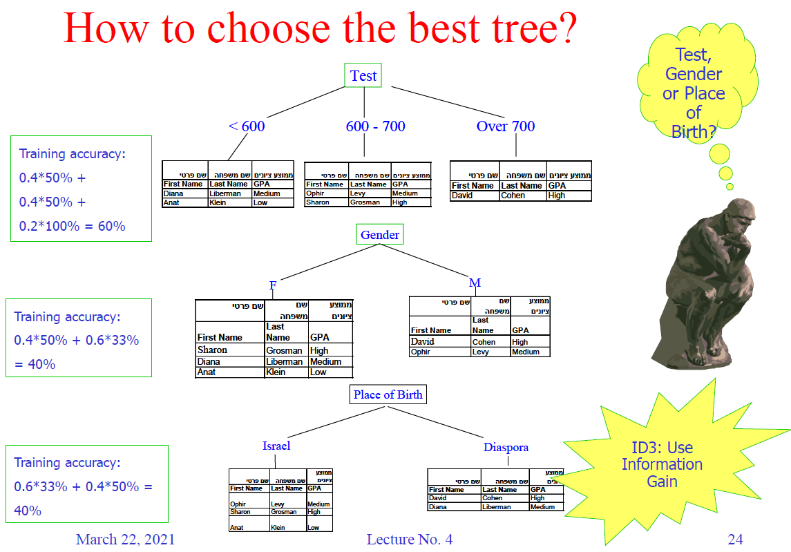
Notes:
Example

Slide 16
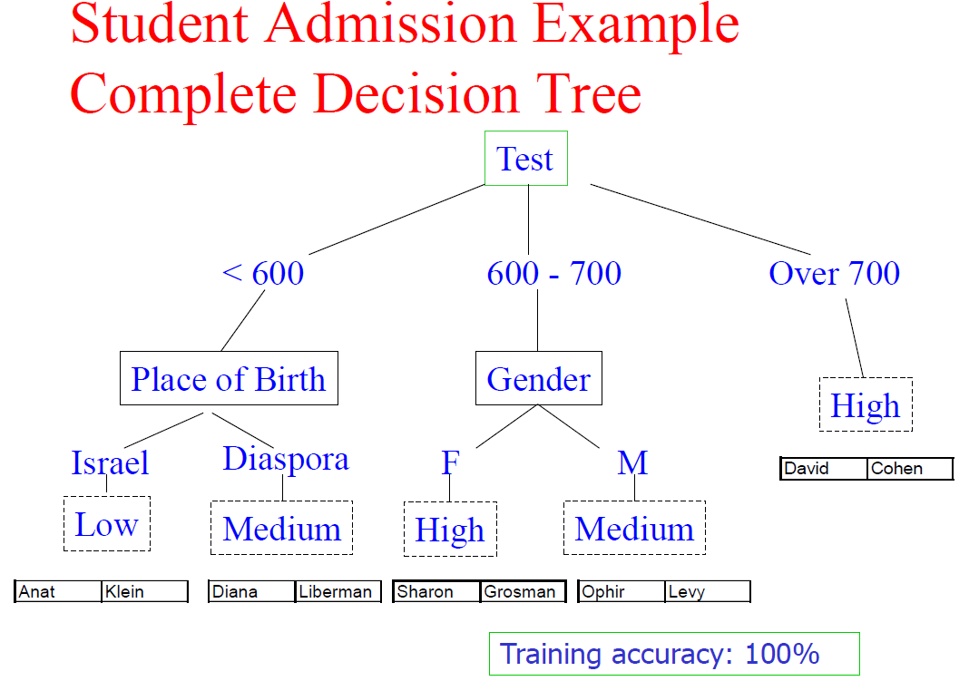
Attribute Selection Measure in ID3 : Information Gain

Slide 17
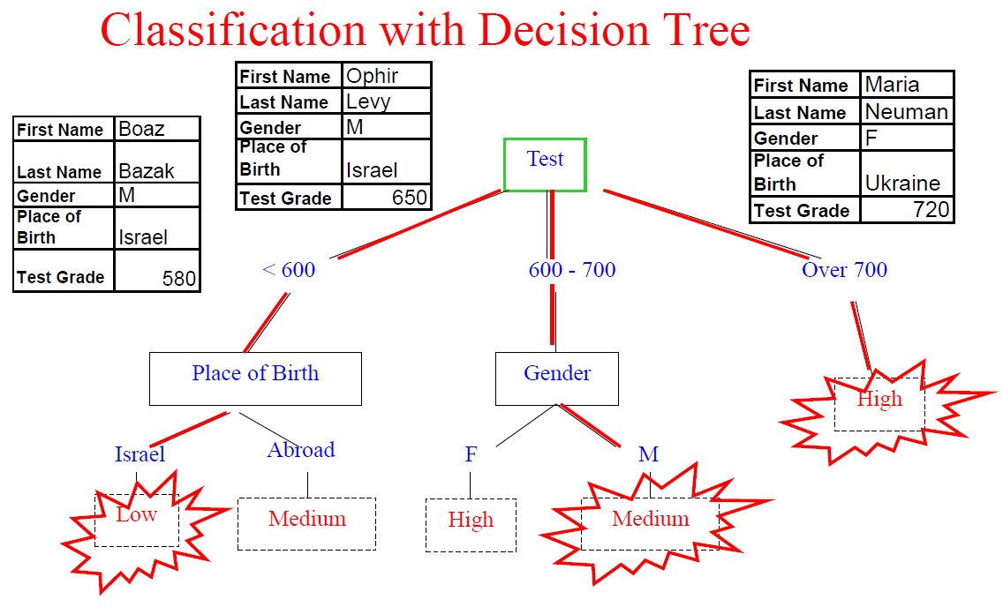
Attribute Selection Measure in ID3 : Information Gain

Slide 18
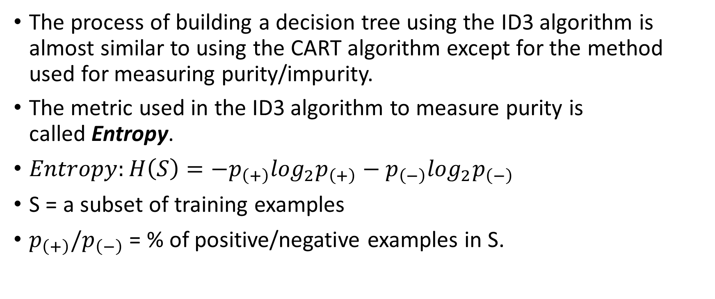
ID3
The process of building a decision tree using the ID3 algorithm is almost similar to using the CART algorithm except for the method used for measuring purity/impurity.
The metric used in the ID3 algorithm to measure purity is called Entropy.
$Entropy:H\left(S\right)=−p_{\left(+\right)}\log_{2}p_{\left(+\right)}−p_{\left(−\right)}\log_{2}p_{\left(−\right)}$
S = a subset of training examples
$p_{\left(+\right)}/p_{\left(−\right)}$ = % of positive/negative examples in S.

Slide 19
Algorithm for Decision Tree Induction
Basic algorithm (a greedy algorithm)
Tree is constructed in a top-down recursive divide-and-conquer manner
At start, all the training examples are at the root
Attributes are categorical (if continuous-valued, they are discretized in advance)
Examples are partitioned recursively based on selected attributes
Test attributes are selected on the basis of a heuristic or statistical measure (e.g., information gain)
Conditions for stopping partitioning
All samples for a given node belong to the same class
There are no remaining attributes for further partitioning – majority voting is employed for classifying the leaf
There are no samples left

Slide 20
Algorithm for Decision Tree Induction
Basic algorithm (greedy)
Tree is constructed in a top-down recursive divide-and-conquer manner
At start, all the training examples are at the root
Attributes are categorical (if continuous-valued, discretized in advance)
Examples are partitioned recursively based on selected attributes
Test attributes are selected on the basis of a heuristic or a statistical measure (e.g., information gain)
Conditions to stop partitioning
All samples for a given node belong to the same class
There are no remaining attributes – majority voting is employed for classifying the leaf
There are no samples left - majority voting

Slide 21
Basic Decision Tree Learning ID3 Algorithm (based on Quinlan, Induction of Decision Trees, 1986)
Create a root node for the tree
If all examples have the same target value, return the single-node tree root labeled by that value
If there no attributes left, return the single-node tree root labeled by the most common value in the examples
Otherwise begin

Slide 22
ID3 Algorithm (cont’d)
Select the attribute A that best classifies the examples
Repeat for each possible value of A
Split the tree (add a new branch to the tree corresponding to each value v of the attribute A)
If there are no examples having value v for the attribute A
Add a leaf node below this branch labeled by the most common value in the examples
Else
Create a subtree below this new branch

Slide 23
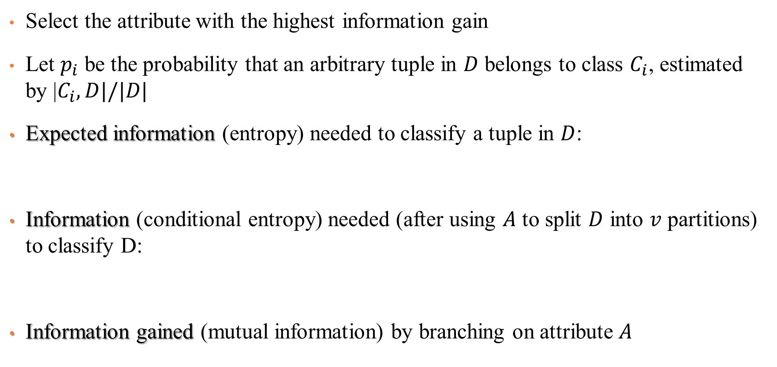
Attribute Selection in ID3 : Information Gain
Select the attribute with the highest information gain
Let $p_{i}$ be the probability that an arbitrary tuple in $D$ belongs to class $C_{i}$, estimated by |$C_{i}, D|/|D|$
Expected information (entropy) needed to classify a tuple in $D$:
Information (conditional entropy) needed (after using $A$ to split $D$ into $v$ partitions) to classify D:
Information gained (mutual information) by branching on attribute $A$

Slide 24
Entropy
Entropy is a way to measure the uncertainty of a class in a subset of examples.
Assume item belongs to subset S having two classes positive and negative.
Entropy is defined as the no. of bits needed to say whether x is positive or negative.
Entropy always gives a number between 0 and 1.
So if a subset formed after separation using an attribute is pure, then we will be needing zero bits to tell if is positive or negative.
If the subset formed is having equal no. of positive and negative items then the no. of bits needed would be 1.

Slide 25
Entropy
Entropy tells us how pure or impure each subset is after the split.
What we need to do is aggregate these scores to check whether the split is feasible or not.
This is done by Information gain

Slide 26
Example
Decision (Class) | Money | Parents | Weather | Week
Cinema | Rich | Yes | Sunny | W1
Tennis | Rich | No | Sunny | W2
Cinema | Rich | Yes | Windy | W3
Cinema | Poor | Yes | Rainy | W4
Stay in | Rich | No | Rainy | W5
Cinema | Poor | Yes | Rainy | W6
Cinema | Poor | No | Windy | W7
Shopping | Rich | No | Windy | W8
Cinema | Rich | Yes | Windy | W9
Tennis | Rich | No | Sunny | W10

Slide 27
ID3 algorithm (Example)
Root node
Cinema=6, Tennis = 2, StayIn=1, Shopping=1

Slide 28
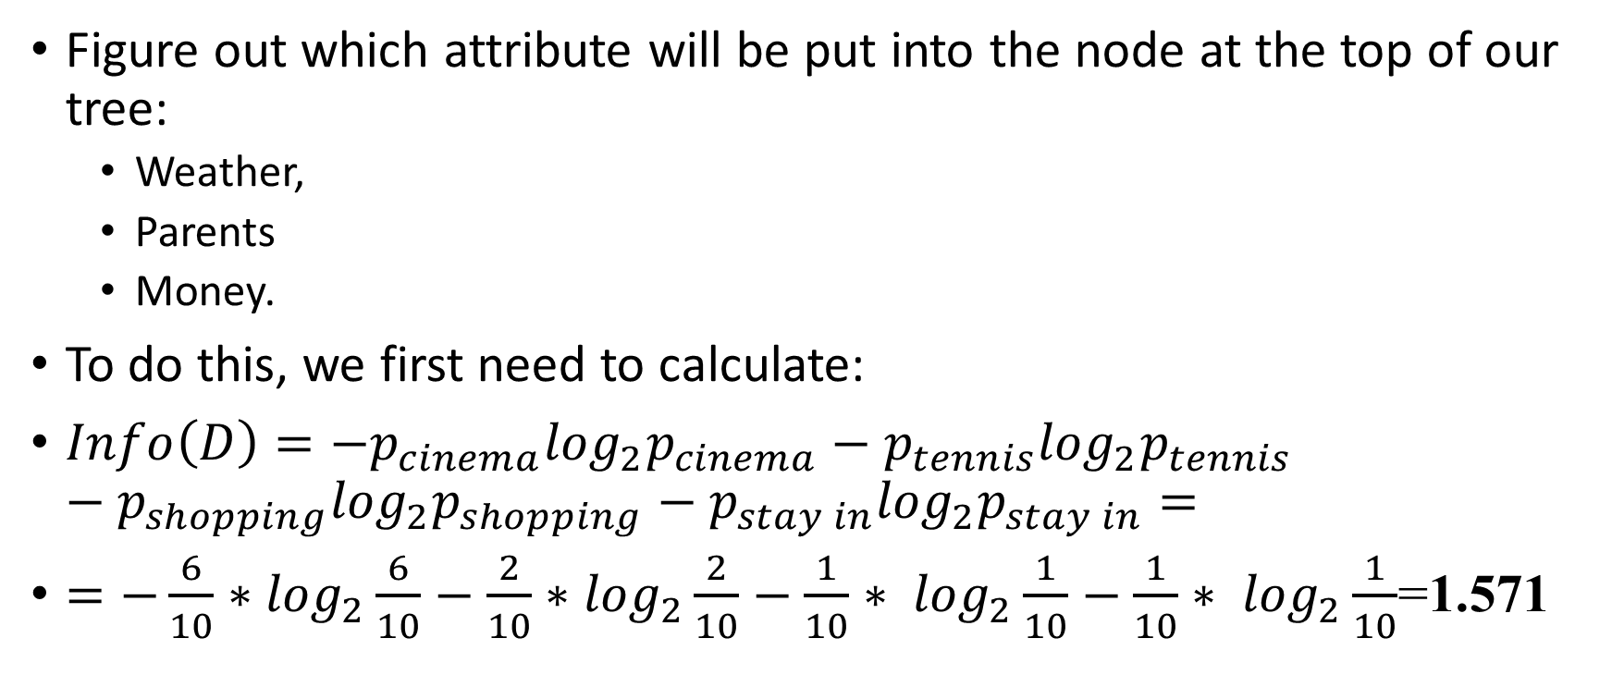
ID3
Figure out which attribute will be put into the node at the top of our tree:
Weather,
Parents
Money.
To do this, we first need to calculate:
$Info\left(D\right)=−p_{cinema}\log_{2}p_{cinema}−p_{tennis}\log_{2}p_{tennis}−p_{shopping}\log_{2}p_{shopping}−p_{stay in}\log_{2}p_{stay in}=$
$=−\frac{6}{10}∗$ $\log_{2}\frac{6}{10}−$ $\frac{2}{10}∗$ $\log_{2}\frac{2}{10}−\frac{1}{10}∗ \log_{2}\frac{1}{10}−\frac{1}{10}∗ \log_{2}\frac{1}{10}$=1.571

Slide 29
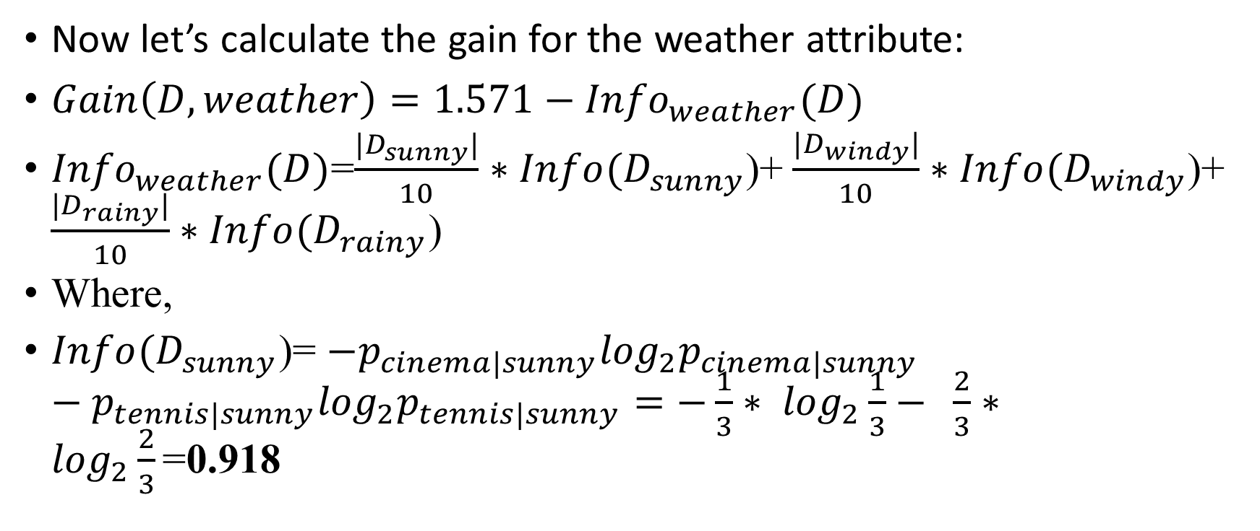
ID3
Now let’s calculate the gain for the weather attribute:
$Gain\left(D,weather\right)=1.571−{Info}_{weather}(D)$
${Info}_{weather}(D)$=$\frac{|D_{sunny}|}{10}∗Info(D_{sunny}$)+ $\frac{|D_{windy}|}{10}∗Info(D_{windy}$)+ $\frac{|D_{rainy}|}{10}∗Info(D_{rainy}$)
Where,
$Info(D_{sunny}$)= $−p_{cinema|sunny}\log_{2}p_{cinema|sunny}−p_{tennis|sunny}\log_{2}p_{tennis|sunny}=−\frac{1}{3}∗ \log_{2}\frac{1}{3}− \frac{2}{3}∗ \log_{2}\frac{2}{3}\text{=}\text{0.918}$
(2,1,0,0)

Slide 30
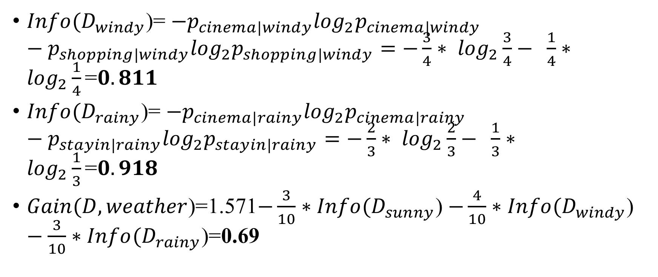
ID3
(3,0,1,0)
$Info(D_{windy}$)= $−p_{cinema|windy}\log_{2}p_{cinema|windy}−p_{shopping|windy}\log_{2}p_{shopping|windy}=−\frac{3}{4}∗ \log_{2}\frac{3}{4}− \frac{1}{4}∗ \log_{2}\frac{1}{4}\text{=}0.811$
$Info(D_{rainy}$)= $−p_{cinema|rainy}\log_{2}p_{cinema|rainy}−p_{stayin|rainy}\log_{2}p_{stayin|rainy}=−\frac{2}{3}∗ \log_{2}\frac{2}{3}− \frac{1}{3}∗ \log_{2}\frac{1}{3}\text{=}0.918$
$Gain(D,weather$)=1.571$−\frac{3}{10}∗Info(D_{sunny}\text{)}$ $−\frac{4}{10}∗Info(D_{windy}\text{)}$ $−\frac{3}{10}∗Info(D_{rainy}\text{)}\text{=}\text{0.69}$
(2,0,0,1)

Slide 31
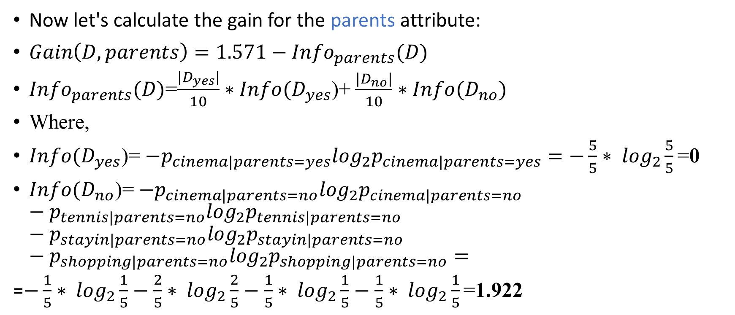
ID3
Now let's calculate the gain for the parents attribute:
$Gain\left(D, parents\right)=1.571−{Info}_{parents}(D)$
${Info}_{parents}(D)$=$\frac{|D_{yes}|}{10}∗Info(D_{yes}$)+ $\frac{|D_{no}|}{10}∗Info(D_{no})$
Where,
$Info(D_{yes}$)= $−p_{cinema|parents=yes}\log_{2}p_{cinema|parents=yes}=−\frac{5}{5}∗ \log_{2}\frac{5}{5}\text{=}\text{0}$
$Info(D_{no}$)= $−p_{cinema|parents=no}\log_{2}p_{cinema|parents=no}−p_{tennis|parents=no}\log_{2}p_{tennis|parents=no}−p_{stayin|parents=no}\log_{2}p_{stayin|parents=no}−p_{shopping|parents=no}\log_{2}p_{shopping|parents=no}=$
=$−\frac{1}{5}∗ \log_{2}\frac{1}{5}−\frac{2}{5}∗ \log_{2}\frac{2}{5}−\frac{1}{5}∗ \log_{2}\frac{1}{5}−\frac{1}{5}∗ \log_{2}\frac{1}{5}\text{=}\text{1.922}$

Slide 32

ID3
Now let’s calculate the gain for the parents attribute:
$Gain\left(D, parents\right)=1.571−{Info}_{parents}(D)$=
=$1.571−\frac{5}{10}∗Info(D_{yes}\text{)}−\frac{5}{10}∗Info(D_{no})$=0.61

Slide 33
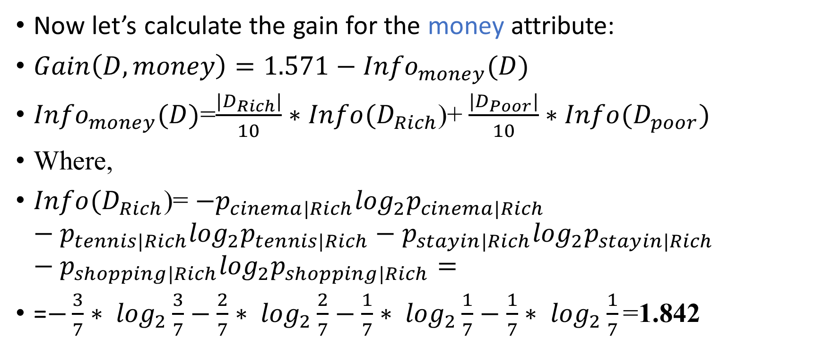
ID3
Now let’s calculate the gain for the money attribute:
$Gain\left(D, money\right)=1.571−{Info}_{money}(D)$
${Info}_{money}(D)$=$\frac{|D_{Rich}|}{10}∗Info(D_{Rich}$)+ $\frac{|D_{Poor}|}{10}∗Info(D_{poor})$
Where,
$Info(D_{Rich}$)= $−p_{cinema|Rich}\log_{2}p_{cinema|Rich}−p_{tennis|Rich}\log_{2}p_{tennis|Rich}−p_{stayin|Rich}\log_{2}p_{stayin|Rich}−p_{shopping|Rich}\log_{2}p_{shopping|Rich}=$
=$−\frac{3}{7}∗ \log_{2}\frac{3}{7}−\frac{2}{7}∗ \log_{2}\frac{2}{7}−\frac{1}{7}∗ \log_{2}\frac{1}{7}−\frac{1}{7}∗ \log_{2}\frac{1}{7}\text{=}\text{1.842}$

Slide 34
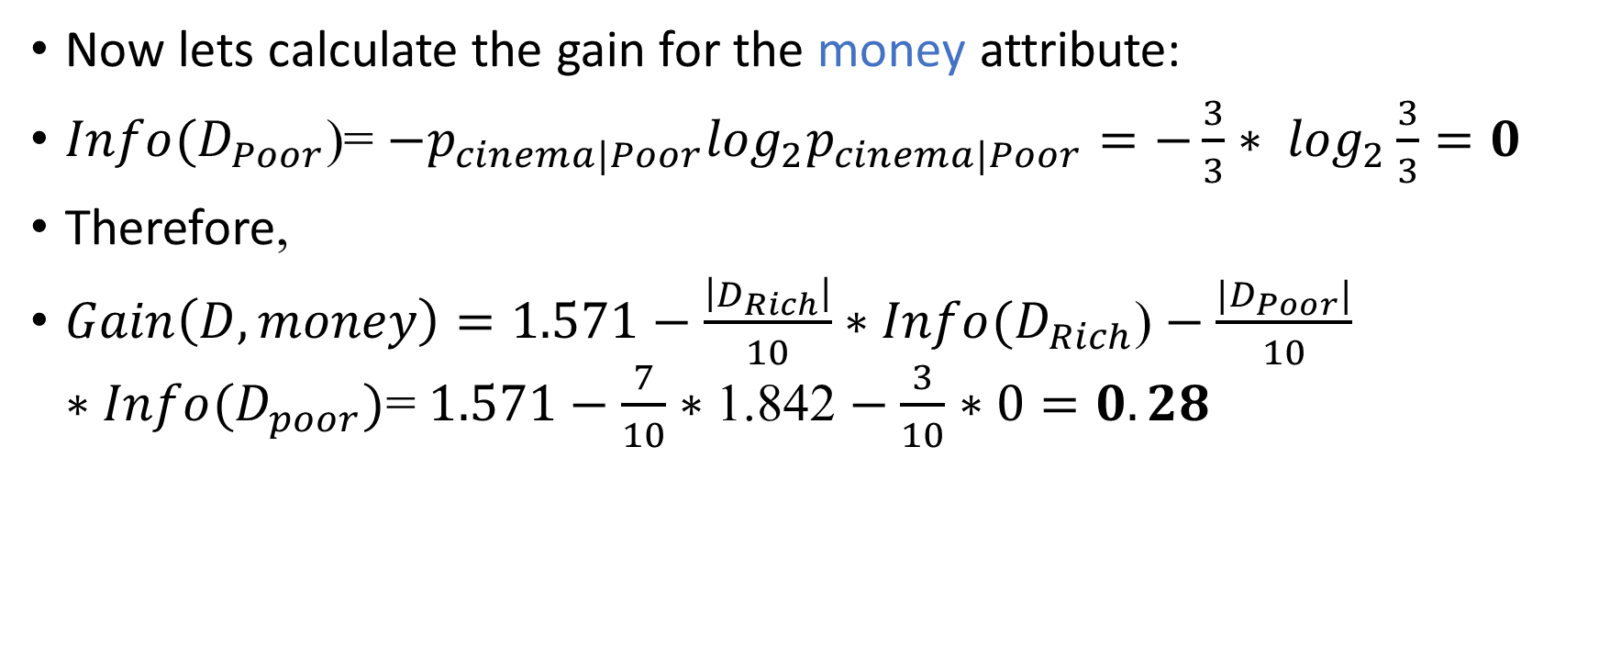
ID3
Now lets calculate the gain for the money attribute:
$Info(D_{Poor}$)= $−p_{cinema|Poor}\log_{2}p_{cinema|Poor}=−\frac{3}{3}∗ \log_{2}\frac{3}{3}=0$
Therefore,
$Gain\left(D, money\right)=1.571−\frac{\left|D_{Rich}\right|}{10}∗Info(D_{Rich}\text{)}−\frac{|D_{Poor}|}{10}∗Info(D_{poor})$= $1.571−\frac{7}{10}∗\text{1.842}−\frac{3}{10}∗0=0.28$

Slide 35
ID3
Information Gain | Attribute
0.69 | Weather
0.61 | Parents
0.28 | Money

Slide 36
ID3 algorithm (Example)
Root node
Cinema=6, Tennis = 2, StayIn=1, Shopping=1
Weather
Sunny (n=3)
Cinema=1, Tennis = 2, StayIn=0, Shopping=0
Windy (n=4)
Cinema=3, Tennis = 0, StayIn=1, Shopping=0
Rainy (n=3)
Cinema=2, Tennis = 0, StayIn=1, Shopping=0

Slide 37

ID3 algorithm (Example)
Root node
Cinema=6, Tennis = 2, StayIn=1, Shopping=1
The first node in the decision tree will be the weather attribute.
Now we look at the first branch. $S_{Sunny}$ = {W1, W2, W10}.
Weather
Sunny (n=3)
Cinema=1, Tennis = 2, StayIn=0, Shopping=0
Windy (n=4)
Cinema=3, Tennis = 0, StayIn=1, Shopping=0
Rainy (n=3)
Cinema=2, Tennis = 0, StayIn=1, Shopping=0

Slide 38

ID3
Now we have to fill in the choice of attribute 𝐴, which we know cannot be weather, because we've already removed that from the list of attributes to use.
So, we need to calculate the values for 𝐺𝑎𝑖𝑛($D_{Sunny}$, 𝑝𝑎𝑟𝑒𝑛𝑡𝑠) and 𝐺𝑎𝑖𝑛($D_{Sunny}$, 𝑚𝑜𝑛𝑒𝑦).
Decision (Class) | Money | Parents | Weather | Week
Cinema | Rich | Yes | Sunny | W1
Tennis | Rich | No | Sunny | W2
Tennis | Rich | No | Sunny | W10

Slide 39
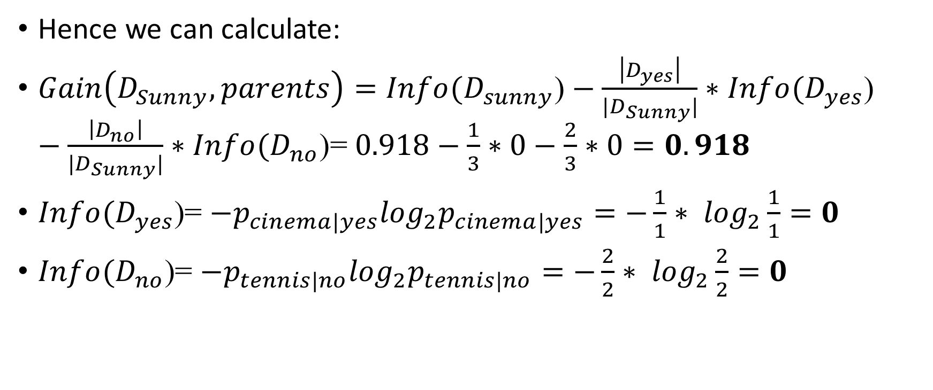
Example
Hence we can calculate:
$Gain\left(D_{Sunny}, parents\right)=Info(D_{sunny}\text{)}−\frac{\left|D_{yes}\right|}{{|D}_{Sunny}|}∗Info(D_{yes}\text{)}−\frac{\left|D_{no}\right|}{{|D}_{Sunny}|}∗Info(D_{no}\text{)}$= $0.918−\frac{1}{3}∗0−\frac{2}{3}∗0=0.918$
$Info(D_{yes}$)= $−p_{cinema|yes}\log_{2}p_{cinema|yes}=−\frac{1}{1}∗ \log_{2}\frac{1}{1}=0$
$Info(D_{no}$)= $−p_{tennis|no}\log_{2}p_{tennis|no}=−\frac{2}{2}∗ \log_{2}\frac{2}{2}=0$

Slide 40
ID3
Now we have to fill in the choice of attribute 𝐴, which we know cannot be weather, because we've already removed that from the list of attributes to use.
So, we need to calculate the values for 𝐺𝑎𝑖𝑛($D_{Sunny}$, 𝑝𝑎𝑟𝑒𝑛𝑡𝑠) and 𝐺𝑎𝑖𝑛($D_{Sunny}$, 𝑚𝑜𝑛𝑒𝑦).
Decision (Class) | Money | Parents | Weather | Week
Cinema | Rich | Yes | Sunny | W1
Tennis | Rich | No | Sunny | W2
Tennis | Rich | No | Sunny | W10

Slide 41
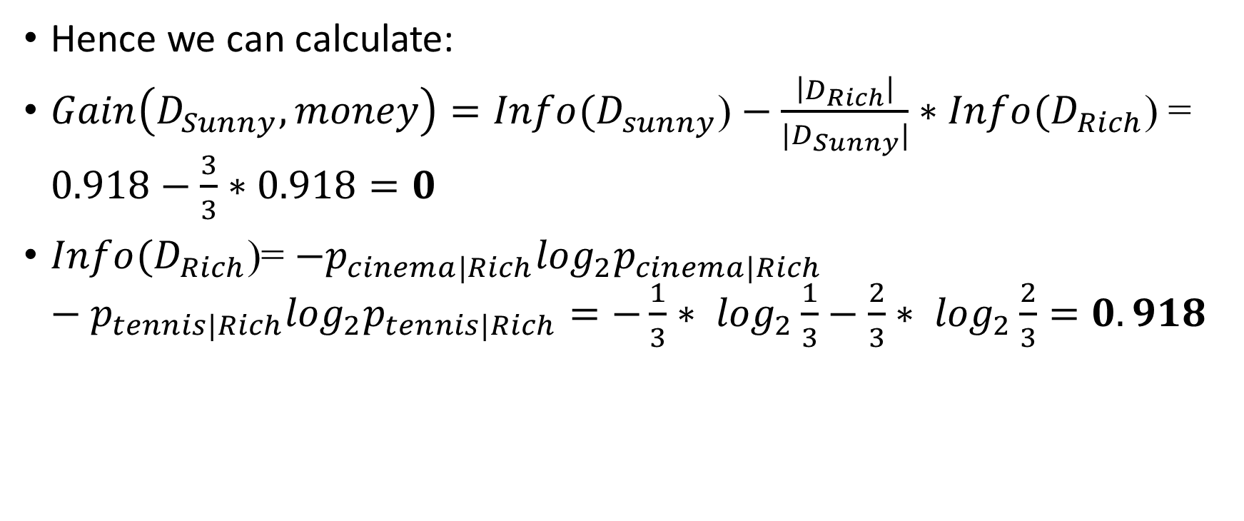
Example
Hence we can calculate:
$Gain\left(D_{Sunny}, money\right)=Info(D_{sunny}\text{)}−\frac{\left|D_{Rich}\right|}{{|D}_{Sunny}|}∗Info(D_{Rich}\text{)}$= $0.918−\frac{3}{3}∗0.918=0$
$Info(D_{Rich}$)= $−p_{cinema|Rich}\log_{2}p_{cinema|Rich}−p_{tennis|Rich}\log_{2}p_{tennis|Rich}=−\frac{1}{3}∗ \log_{2}\frac{1}{3}−\frac{2}{3}∗ \log_{2}\frac{2}{3}=0.918$

Slide 42
ID3
Information Gain | Attribute
0.918 | Parents
0 | Money

Slide 43
ID3 algorithm (Example)
Root node
Cinema=6, Tennis = 2, StayIn=1, Shopping=1
Weather
Sunny (n=3)
Cinema=1, Tennis = 2, StayIn=0, Shopping=0
Windy (n=4)
Cinema=3, Tennis = 0, StayIn=1, Shopping=0
Rainy (n=3)
Cinema=2, Tennis = 0, StayIn=1, Shopping=0
Yes (n=1)
Cinema=1
No (n=2)
Tennis=2

Slide 44

Example
Decision (Class) | Money | Parents | Weather | Week
Cinema | Rich | Yes | Windy | W3
Cinema | Poor | No | Windy | W7
Shopping | Rich | No | Windy | W8
Cinema | Rich | Yes | Windy | W9
Now we need to calculate the values for Gain($D_{Windy}$, parents) and Gain($D_{Windy}$, money).

Slide 45

ID3
Now we need to calculate the values for 𝐺𝑎𝑖𝑛($D_{Windy}$, 𝑝𝑎𝑟𝑒𝑛𝑡𝑠) and 𝐺𝑎𝑖𝑛($D_{Windy}$, 𝑚𝑜𝑛𝑒𝑦).
Decision (Class) | Money | Parents | Weather | Week
Cinema | Rich | Yes | Windy | W3
Cinema | Poor | No | Windy | W7
Shopping | Rich | No | Windy | W8
Cinema | Rich | Yes | Windy | W9

Slide 46
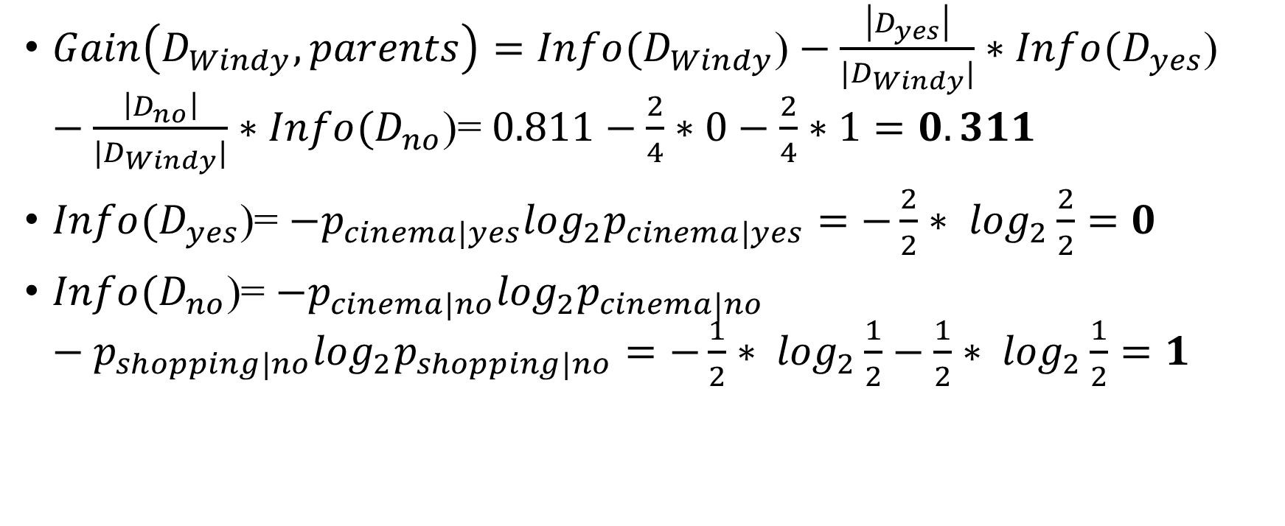
Example
$Gain\left(D_{Windy}, parents\right)=Info(D_{Windy}\text{)}−\frac{\left|D_{yes}\right|}{{|D}_{Windy}|}∗Info(D_{yes}\text{)}−\frac{\left|D_{no}\right|}{|D_{Windy}|}∗Info(D_{no}\text{)}$= $0.811−\frac{2}{4}∗0−\frac{2}{4}∗1=0.311$
$Info(D_{yes}$)= $−p_{cinema|yes}\log_{2}p_{cinema|yes}=−\frac{2}{2}∗ \log_{2}\frac{2}{2}=0$
$Info(D_{no}$)= $−p_{cinema|no}\log_{2}p_{cinema|no}−p_{shopping|no}\log_{2}p_{shopping|no}=−\frac{1}{2}∗ \log_{2}\frac{1}{2}−\frac{1}{2}∗ \log_{2}\frac{1}{2}=1$

Slide 47
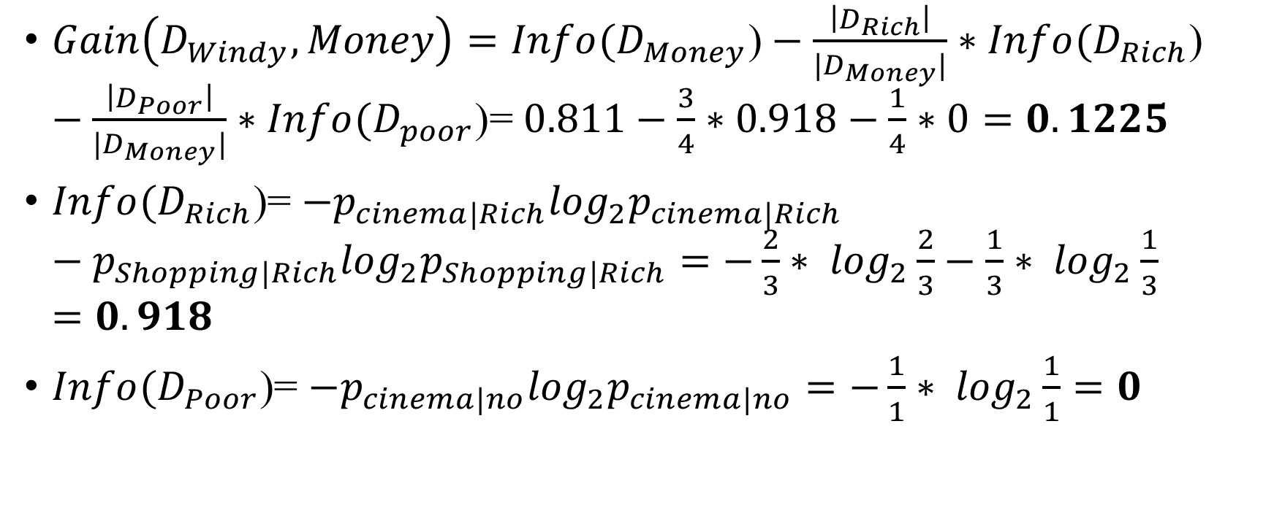
Example
$Gain\left(D_{Windy},Money\right)=Info(D_{Money}\text{)}−\frac{\left|D_{Rich}\right|}{{|D}_{Money}|}∗Info(D_{Rich}\text{)}−\frac{\left|D_{Poor}\right|}{|D_{Money}|}∗Info(D_{poor}\text{)}$= $0.811−\frac{3}{4}∗0.918−\frac{1}{4}∗0=0.1225$
$Info(D_{Rich}$)= $−p_{cinema|Rich}\log_{2}p_{cinema|Rich}−p_{Shopping|Rich}\log_{2}p_{Shopping|Rich}=−\frac{2}{3}∗ \log_{2}\frac{2}{3}−\frac{1}{3}∗ \log_{2}\frac{1}{3}=0.918$
$Info(D_{Poor}$)= $−p_{cinema|no}\log_{2}p_{cinema|no}=−\frac{1}{1}∗ \log_{2}\frac{1}{1}=0$

Slide 48
ID3
Meaning that this node will be split by parents too.
After calculating the Gain for rainy too, the final tree is…
Information Gain | Attribute
0.311 | Parents
0.1225 | Money

Slide 49
ID3 algorithm (Example)
Root node
Cinema=6, Tennis = 2, StayIn=1, Shopping=1
Weather
Sunny (n=3)
Cinema=1, Tennis = 2, StayIn=0, Shopping=0
Windy (n=4)
Cinema=3, Tennis = 0, StayIn=1, Shopping=0
Rainy (n=3)
Cinema=2, Tennis = 0, StayIn=1, Shopping=0
Parents
Parents
Money
Yes (n=1)
Cinema=1
No (n=2)
Tennis=2
Yes (n=2)
Cinema=2
No (n=2)
Cinema=1, Shopping=1
Rich (n=1)
Stayin=1
Poor (n=2)
Cinema=2
Rich (n=1)
Shopping=1
Poor (n=1)
Cinema=1

Slide 50
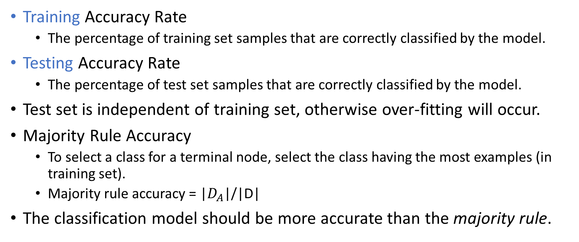
Accuracy Estimation
Training Accuracy Rate
The percentage of training set samples that are correctly classified by the model.
Testing Accuracy Rate
The percentage of test set samples that are correctly classified by the model.
Test set is independent of training set, otherwise over-fitting will occur.
Majority Rule Accuracy
To select a class for a terminal node, select the class having the most examples (in training set).
Majority rule accuracy = |$D_{A}$|/|D|
The classification model should be more accurate than the majority rule.

Slide 51

Accuracy Estimation
How can we tell if the training accuracy is significantly different than the testing accuracy?
Normal approximation to Binomial distribution $H_{0}$: The two accuracies are equal. We reject $H_{0}$ if:
number of samples in the testing set
Testing accuracy
If training accuracy > testing accuracy
training accuracy
Over-fitting
P=0.51 → Testing accuracy should be 51% at the most, for the two accuracies to be significantly different (to reject $H_{0}$).
Notes:
P^ - מסמן את רמת הדיוק של training set
P – מסמן את רמת הדיוק של testing set
N - מספר התצפיות בטסט סט
בקשר ל-Z
הוא שווה ל-1.96. זה בעצם הרווח בר סמך של 95%.

Slide 52
Example
Decision (Class) | Money | Parents | Weather | Week
Cinema | Rich | Yes | Sunny | W1
Tennis | Rich | No | Sunny | W2
Cinema | Rich | Yes | Windy | W3
Cinema | Poor | Yes | Rainy | W4
Stay in | Rich | No | Rainy | W5
Cinema | Poor | Yes | Rainy | W6
Cinema | Poor | No | Windy | W7
Shopping | Rich | No | Windy | W8
Cinema | Rich | Yes | Windy | W9
Tennis | Rich | No | Sunny | W10

Slide 53
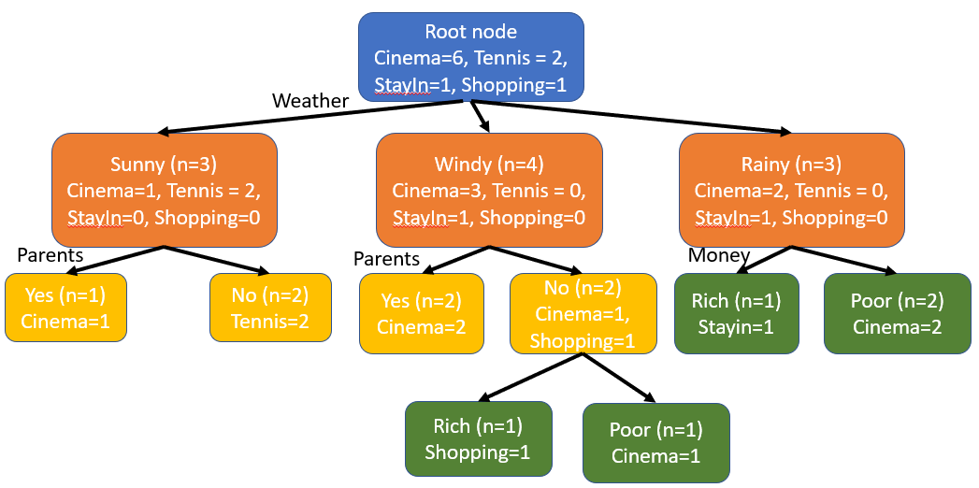
Accuracy Estimation
In our example, training accuracy is ?
Take the following testing set for example:
Decision (Class) | Money | Parents | Weather | Week
Cinema | Poor | Yes | Sunny | W11
Tennis | Rich | No | Sunny | W12
Cinema | Rich | No | Windy | W13
Cinema | Poor | Yes | Rainy | W14
Testing accuracy is: ?
Majority rule accuracy=?
The classification model should be more accurate than the majority rule.
Notes:
Testing accuracy is: ¾=0.75=75%
Majority rule accuracy=6/10=60%

Slide 54
Accuracy Estimation
In our example, training accuracy is 10/10 = 100%
Take the following testing set for example:
Decision (Class) | Money | Parents | Weather | Week
Cinema | Poor | Yes | Sunny | W11
Tennis | Rich | No | Sunny | W12
Cinema | Rich | No | Windy | W13
Cinema | Poor | Yes | Rainy | W14
Testing accuracy is: ¾=0.75=75%
Majority rule accuracy=6/10=60%
The classification model should be more accurate than the majority rule.
Notes:
Testing accuracy is: ¾=0.75=75%
Majority rule accuracy=6/10=60%

Slide 55
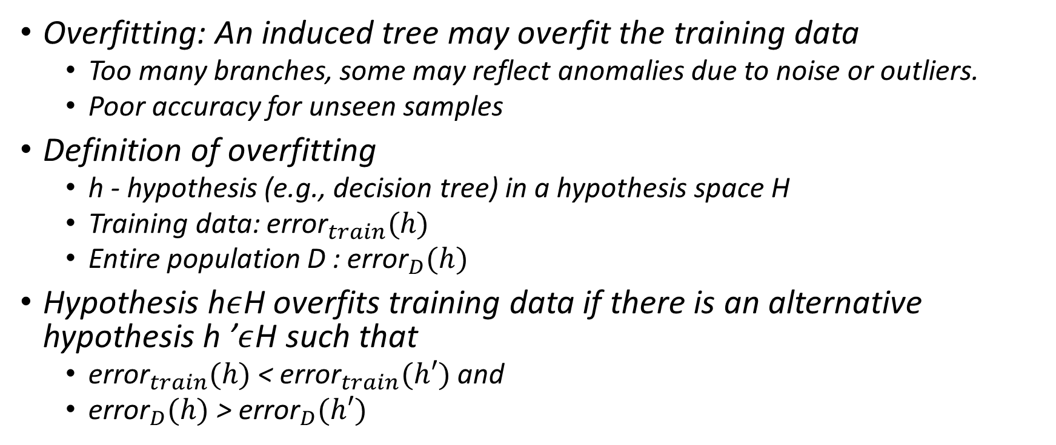
Overfitting
Overfitting: An induced tree may overfit the training data
Too many branches, some may reflect anomalies due to noise or outliers.
Poor accuracy for unseen samples
Definition of overfitting
h - hypothesis (e.g., decision tree) in a hypothesis space H
Training data: ${\text{error}}_{train}(h)$
Entire population D : ${\text{error}}_{D}(h)$
Hypothesis h$ε$H overfits training data if there is an alternative hypothesis h ’$ε$H such that
${\text{error}}_{train}(h)$ < ${\text{error}}_{train}(h′)$ and
${\text{error}}_{D}(h)$ > ${\text{error}}_{D}(h′)$

Slide 56
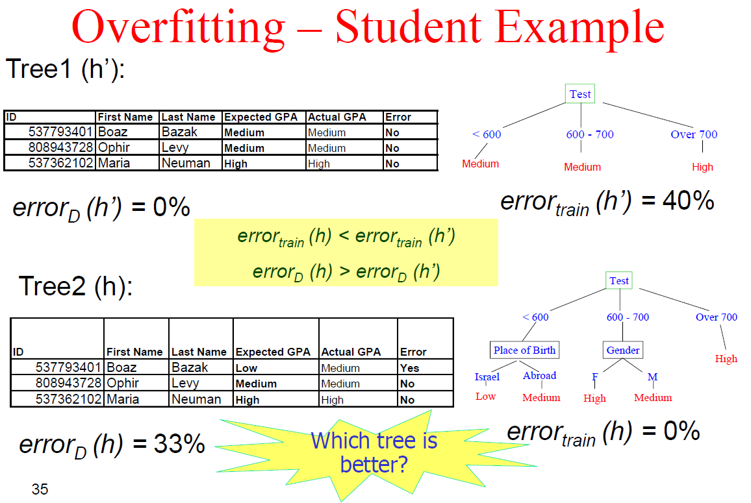
Overfitting
Overfitting: An induced tree may overfit the training data
Too many branches, some may reflect anomalies due to noise or outliers.
Poor accuracy for unseen samples
Definition of overfitting
h - hypothesis (e.g., decision tree) in a hypothesis space H
Training data: ${\text{error}}_{train}(h)$
Entire population D : ${\text{error}}_{D}(h)$
Hypothesis h$ε$H overfits training data if there is an alternative hypothesis h ’$ε$H such that
${\text{error}}_{train}(h)$ < ${\text{error}}_{train}(h′)$ and
${\text{error}}_{D}(h)$ > ${\text{error}}_{D}(h′)$

Slide 57
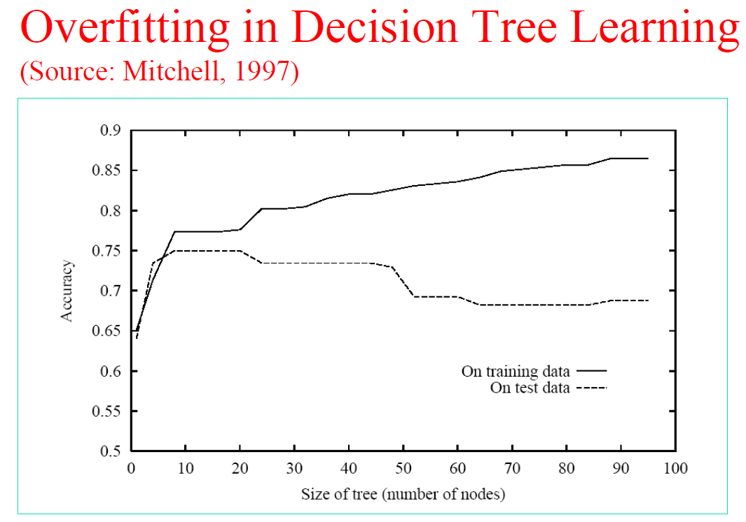
Overfitting
Overfitting: An induced tree may overfit the training data
Too many branches, some may reflect anomalies due to noise or outliers.
Poor accuracy for unseen samples
Definition of overfitting
h - hypothesis (e.g., decision tree) in a hypothesis space H
Training data: ${\text{error}}_{train}(h)$
Entire population D : ${\text{error}}_{D}(h)$
Hypothesis h$ε$H overfits training data if there is an alternative hypothesis h ’$ε$H such that
${\text{error}}_{train}(h)$ < ${\text{error}}_{train}(h′)$ and
${\text{error}}_{D}(h)$ > ${\text{error}}_{D}(h′)$
Notes:
ככל שנגדיל את כמות הקודקודים בעץ, כך הדיוק שלנו יעלה. אבל לא נרצה יותר מדיי כי דיוק על המבחן ירד בסופו של דבר.

Slide 58
Avoiding Overfitting
Two approaches to avoid overfitting
Pre-pruning : Halt tree construction early do not split a node if this would result in the goodness measure falling below a threshold
Difficult to choose an appropriate threshold
Post-pruning : Remove branches from a fully grown ” tree get a sequence of progressively pruned trees
Use a set of data different from the training data to decide which is the best pruned tree
Notes:
Prepruning - גיזום מוקדם. נרצה לעצור את בניית עץ. נקבע איזשהו סף וממנו נפסיק לפתח את קודקודי העץ. הבעיה בזה היא הקושי לבחור תנאי סף מתאים.
Postpruning – נבנה עץ ענק שנדע שהוא לא טוב וננסה לגזום אותו. בדר"כ הגיזום יחל מהרמה הנמוכה ונעלה אט אט.
איך נדע מהו עץ אופטימלי? בכל שלב שאנו גוזמים את העץ, נריץ את ה-test set ונראה אם שיפרנו.

Slide 59
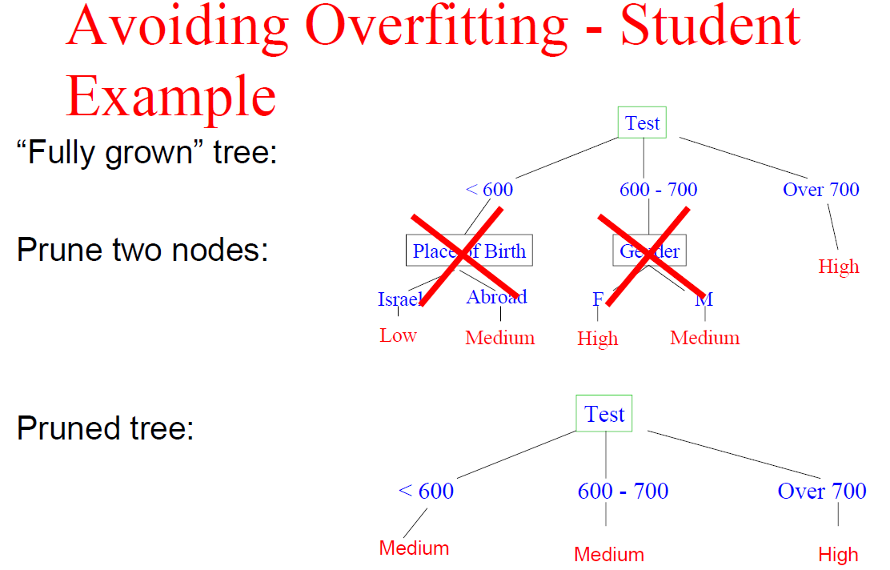
Avoiding Overfitting
Notes:
מבטל את הענפים האלה ומסווג אותם על פי הרוב.

Slide 60
Approaches to Avoid Overfitting and Determine the Final Tree Size
Separate training (2 /3) and testing (1/3 ) sets
Use cross validation, e.g., 10 fold cross validation
Use all the data for training
but apply a statistical test (e.g., chi square) to estimate whether expanding or pruning a node may improve the entire distribution
Use minimum description length (MDL) principle
halting growth of the tree when the encoding is minimized
Notes:
מבטל את הענפים האלה ומסווג אותם על פי הרוב.

Slide 61
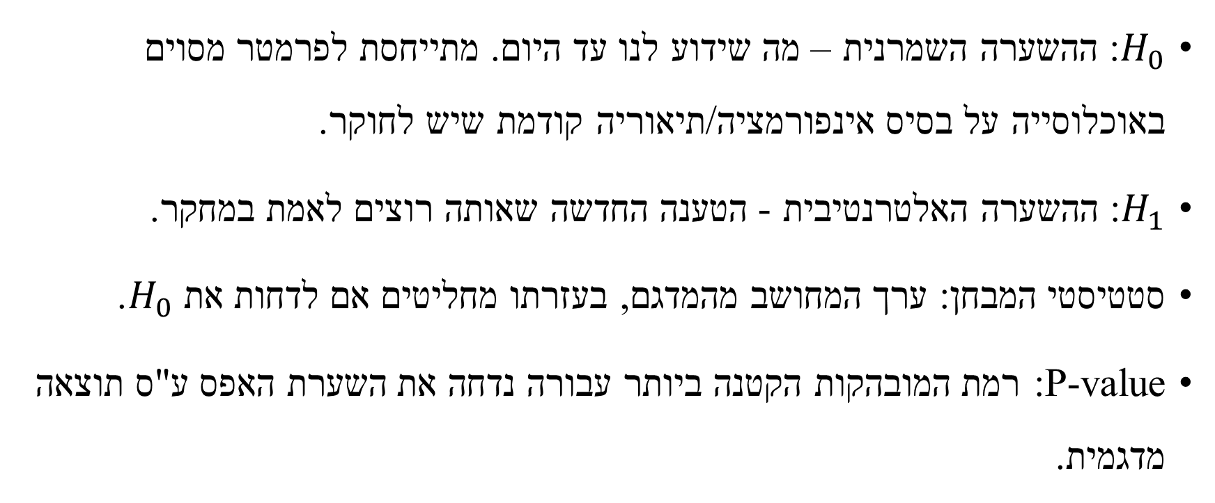
Statistical Hypothesis Testing
$H_{0}$: ההשערה השמרנית – מה שידוע לנו עד היום. מתייחסת לפרמטר מסוים באוכלוסייה על בסיס אינפורמציה/תיאוריה קודמת שיש לחוקר.
$H_{1}$: ההשערה האלטרנטיבית - הטענה החדשה שאותה רוצים לאמת במחקר.
סטטיסטי המבחן: ערך המחושב מהמדגם, בעזרתו מחליטים אם לדחות את $H_{0}$.
P-value: רמת המובהקות הקטנה ביותר עבורה נדחה את השערת האפס ע"ס תוצאה מדגמית.
Notes:
השערת האפס: המשתנה A לא רלוונטי לסיווג. ההשערה האלטרנטיבית המשתנה A כן משפיע כלומר רלוונטי לסיווג. אם נדחה את השערת האפס אזי נפצל את הקודקוד. תנאי בסיסי שהסטטיסטי מתפלג חי בריבוע הוא השערת האפס נכונה. אם נדחה אז זה אומר שזה לא מתפלג חי בריבוע.

Slide 62
Avoiding Overfitting Chi Square Test (based on Quinlan, 1986)
prepruning
Notations:
A - splitting (branching) attribute
v - domain size of attribute A
C_{i} - subset of records containing value i of attribute A
c – number of classes
e_{j} - number of records belonging to class j in the entire data set C
o_{ij} - number of records belonging to class j in subset C_{i}
α - significance level

Slide 63
Avoiding Overfitting Chi Square Test (based on Quinlan, 1986)
Null Hypothesis: attribute A is irrelevant to classifying the records in data set C.
Alternative Hypothesis: attribute A affects the class distribution in data set C.
Notes:
השערת ה-0: המשתנה A לא רלוונטי למשתנה הסיווג.
השערת ה-1: כן משפיע על הסיווג של C.

Slide 64
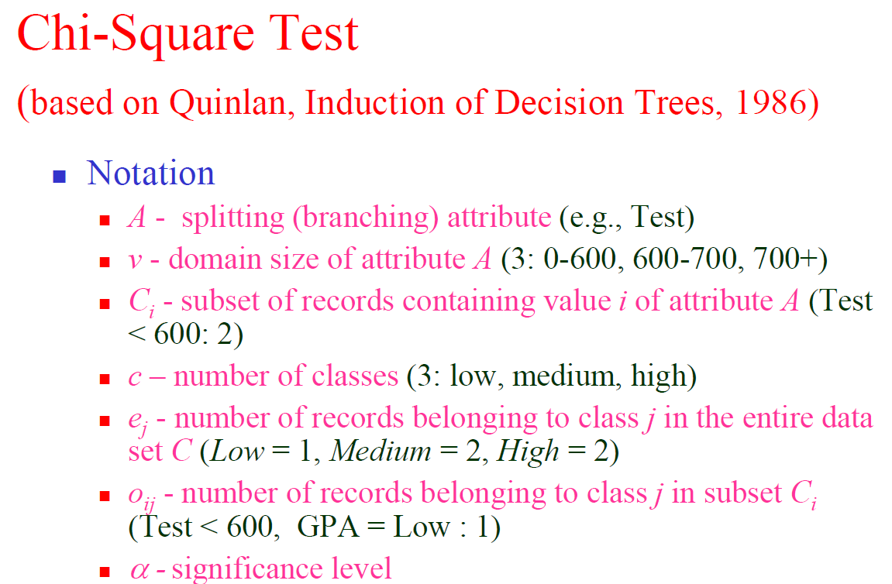
Approaches to Avoid Overfitting and Determine the Final Tree Size
Separate training (2 /3) and testing (1/3 ) sets
Use cross validation, e.g., 10 fold cross validation
Use all the data for training
but apply a statistical test (e.g., chi square) to estimate whether expanding or pruning a node may improve the entire distribution
Use minimum description length (MDL) principle
halting growth of the tree when the encoding is minimized
Notes:
מבטל את הענפים האלה ומסווג אותם על פי הרוב.

Slide 65
Avoiding Overfitting Chi Square Test (based on Quinlan, 1986)
Expected number of records in C_{i}, for class j:
Statistic:

Slide 66

Avoiding Overfitting Chi Square Test (based on Quinlan, 1986)
For two classes – expected number of positive records in $Ci$
Statistic:

Slide 67
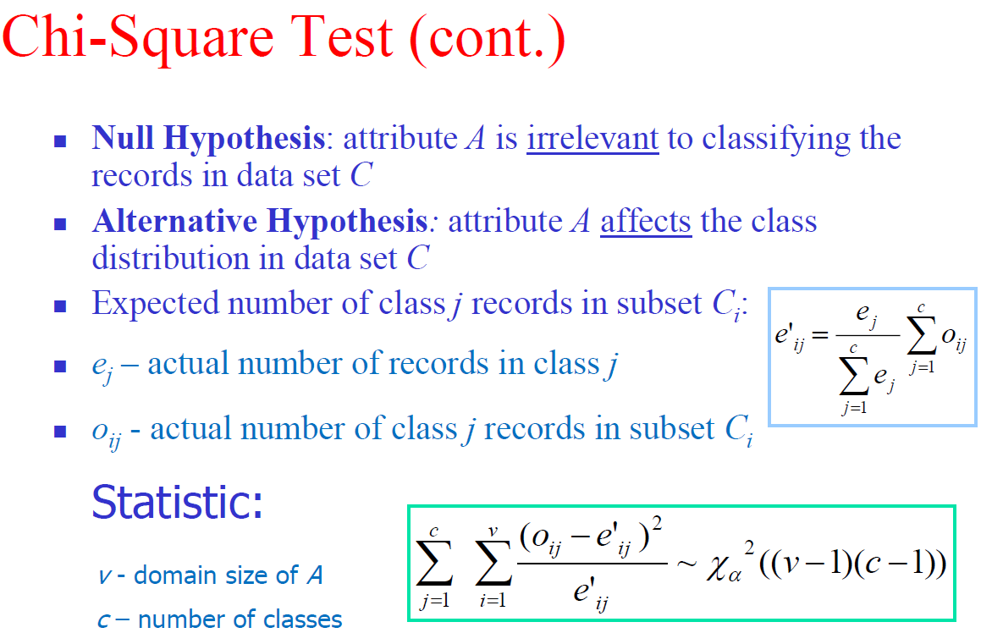
Approaches to Avoid Overfitting and Determine the Final Tree Size
Separate training (2 /3) and testing (1/3 ) sets
Use cross validation, e.g., 10 fold cross validation
Use all the data for training
but apply a statistical test (e.g., chi square) to estimate whether expanding or pruning a node may improve the entire distribution
Use minimum description length (MDL) principle
halting growth of the tree when the encoding is minimized
Notes:
השערת האפס: המשתנה A לא רלוונטי לסיווג. ההשערה האלטרנטיבית המשתנה A כן משפיע כלומר רלוונטי לסיווג. אם נדחה את השערת האפס אזי נפצל את הקודקוד. תנאי בסיסי שהסטטיסטי מתפלג חי בריבוע הוא השערת האפס נכונה. אם נדחה אז זה אומר שזה לא מתפלג חי בריבוע.

Slide 68
Chi-Square Test Example
Weekend
Weather
Parents
Money
Decision (Class)
W1
Sunny
Yes
Rich
Cinema
W2
Sunny
No
Rich
Tennis
W3
Windy
Yes
Rich
Cinema
W4
Rainy
Yes
Poor
Cinema
W5
Rainy
No
Rich
Stay in
W6
Rainy
Yes
Poor
Cinema
W7
Windy
No
Poor
Cinema
W8
Windy
No
Rich
Shopping
W9
Windy
Yes
Rich
Cinema
W10
Sunny
No
Rich
Tennis

Slide 69
Chi-Square Test Example
Entire Data Set before splitting:
Cinema = 6
Tennis = 2
Stay in = 1
Shopping = 1
Split the Data by Weather or Parents or Money?
Notes:
צריך לבחור עפ"י מה לפצל

Slide 70
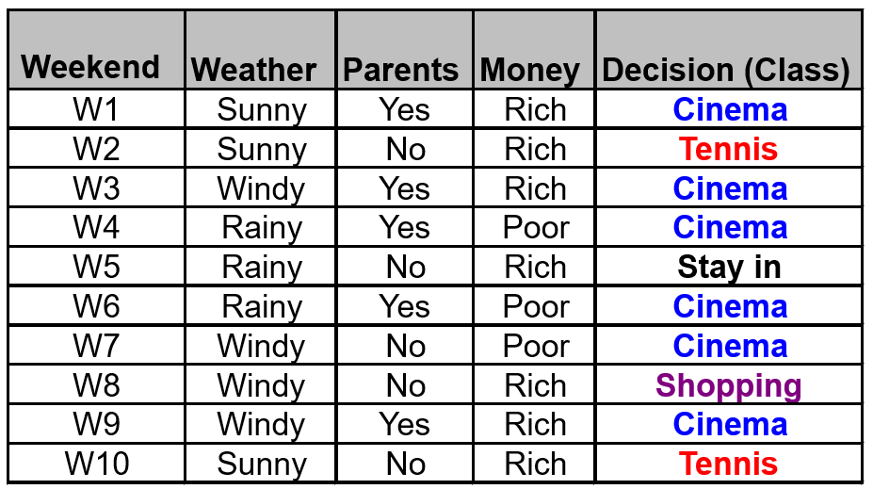
When Weather = Sunny: 2 – Tennis, 1 - Cinema
Splitting by Weather:
Weather = Sunny: C₁ = 1, T₁ = 2, St₁ = 0, Sh₁ =0
C’₁ = (6/10)*(1+2) = 1.8, T’₁ = (2/10)*(1+2) = 0.6
St’₁ = (1/10)*(1+2) = 0.3, Sh’₁ = (1/10)*(1+2) = 0.3
Weather = Windy: C₂ = 3 ,T₂= 0, St₂ = 0, Sh₂ = 1
C’₂ = (6/10)*(3+1) = 2.4, Sh’₂ = (1/10)*(3+1) = 0.4
St’₂= (1/10)*(3+1) = 0.4, T’₂= (2/10)*(3+1) = 0.8
Weather = Rainy: C₃ = 2, T₃ = 0, St₃ = 1, Sh₃= 0
C’₃ = (6/10)*(2+1) = 1.8, St’₃ = (1/10)*(2+1) = 0.3
T’₃ = (2/10)*(2+1) = 0.6, Sh’₃=(1/10)*(2+1) = 0.3

Slide 71
(C₁-C’₁)²/C’₁+(T₁-T’₁)²/T’₁ +(St₁-St’₁)²/St’₁ +(Sh₁-Sh’₁)²/Sh’₁ +
(C₂-C’₂)²/C’₂+(T₂-T’₂)²/T’₂ +(St₂-St’₂)²/St’₂ +(Sh₂-Sh’₂)²/Sh’₂ +
(C₃-C’₃)²/C’₃+(T₃-T’₃)²/T’₃ +(St₃-St’₃)²/St’₃ +(Sh₃-Sh’₃)²/Sh’₃
Sunny
Windy
Rainy

Slide 72
Statistic = (1-1.8)²/1.8+(2-0.6)²/0.6+(0-0.3)²/0.3+(0-0.3)²/0.3+ +(3-2.4)²/2.4+(1-0.4)²/0.4+(0-0.4)²/0.4+(0-0.8)²/0.8+
+(2-1.8)²/1.8+(1-0.3)²/0.3+(0-0.6)²/0.6+(0-0.3)²/0.3 = 9.027
Conclusion – don’t reject the null hypothesis and don’t split the Weather node.
Sunny
Windy
Rainy
Notes:
ב-ID3 קודם בונים את העץ ורק אחר כך בודקים אם אין overfitting.
בחי בריבוע אני בונה מראש עץ שאין בו overfitting.

Slide 73
Parents = Yes: C₁ = 5, T₁=0, St₁=0, Sh₁=0
C’₁=(6/10)*(5)=3, T’₁=(2/10)*(5)=1
St’₁=(1/10)*(5)=0.5, Sh’₁=(1/10)*(5)=0.5
Parents = No: C₂ = 1, T₂=2, St₂=1, Sh₂=1
C’₂=(6/10)*(5)=3, T’₂=(2/10)*(5)=1
St’₂=(1/10)*(5)=0.5, Sh’₂=(1/10)*(5)=0.5
Statistic = (5-3)²/3+(0-1) ²/1+(0-0.5) ²/0.5+(0-0.5) ²/0.5+ +(1-3) ²/3+(2-1) ²/1+(1-0.5) ²/0.5+(1-0.5) ²/0.5 = 6.66
Conclusion – don’t reject the null hypothesis and don’t split the Parents node.

Slide 74
Money = Rich: C₁ = 3, T₁=2, St₁=1, Sh₁=1
C’₁=(6/10)*(3+2+1+1)=4.2, T’₁=(2/10)*(7)=1.4
St’₁=(1/10)*(7)=0.7, Sh’₁=(1/10)*(7)=0.7
Money = Poor: C₂ = 3, T₂=0, St₂=0, Sh₂=0
C’₂=(6/10)*(3)=1.8, T’₂=(2/10)*(3)=0.6
St’₂=(1/10)*(3)=0.3, Sh’₂=(1/10)*(3)=0.3
Statistic = (3-4.2)²/4.2+(2-1.4)²/1.4+(1-0.7)²/0.7+(1-0.7)²/0.7+(3-1.8)²/1.8 + (0-0.6)²/0.6+(0-0.3)²/0.3 +(0-0.3)²/0.3 = 2.85
Conclusion – don’t reject the null hypothesis and don’t split the Parents node.
.

Slide 75
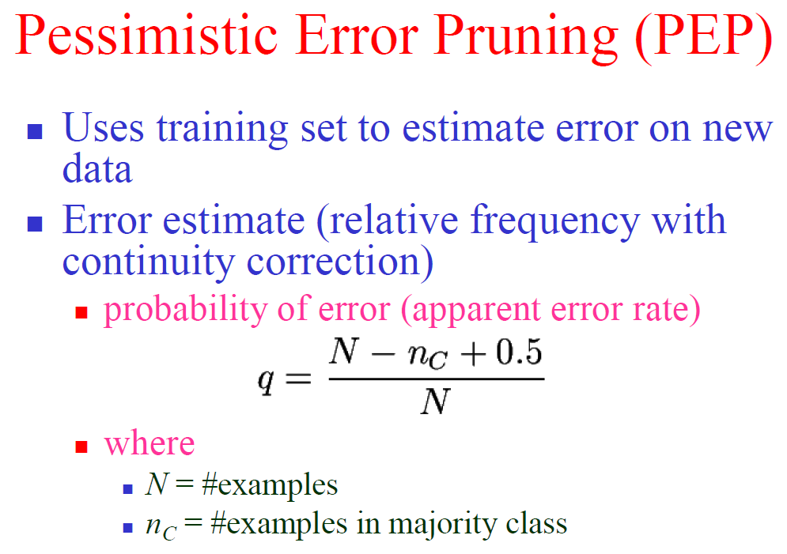
Approaches to Avoid Overfitting and Determine the Final Tree Size
Notes:
עוד מבחן. במקרה כאן קודם נבנה את העץ ורק אחר כך נבצע גיזום.
החצי שמחברים במשוואה היא עבור תיקון הרציפות.

Slide 76
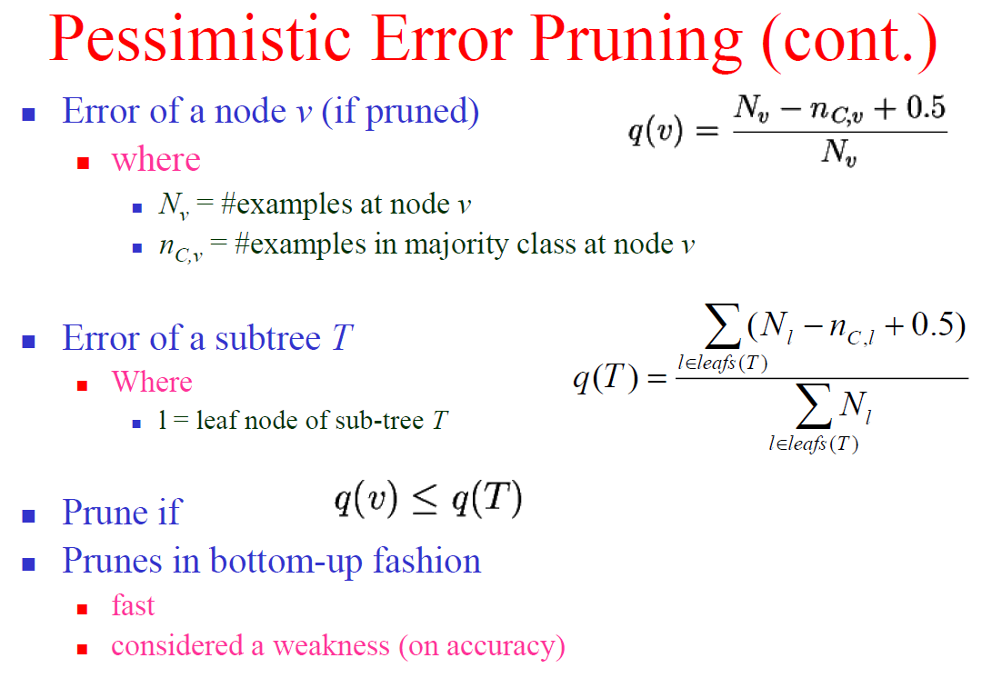
Approaches to Avoid Overfitting and Determine the Final Tree Size
Notes:
Q(v)- הטעות לפני הגיזום
Q(T) – הטעות אחרי הגיזום.
נגזום אם הטעות לפני הגיזום קטנה מהטעות אחרי הגיזום אזי נבצע גיזום.

Slide 77
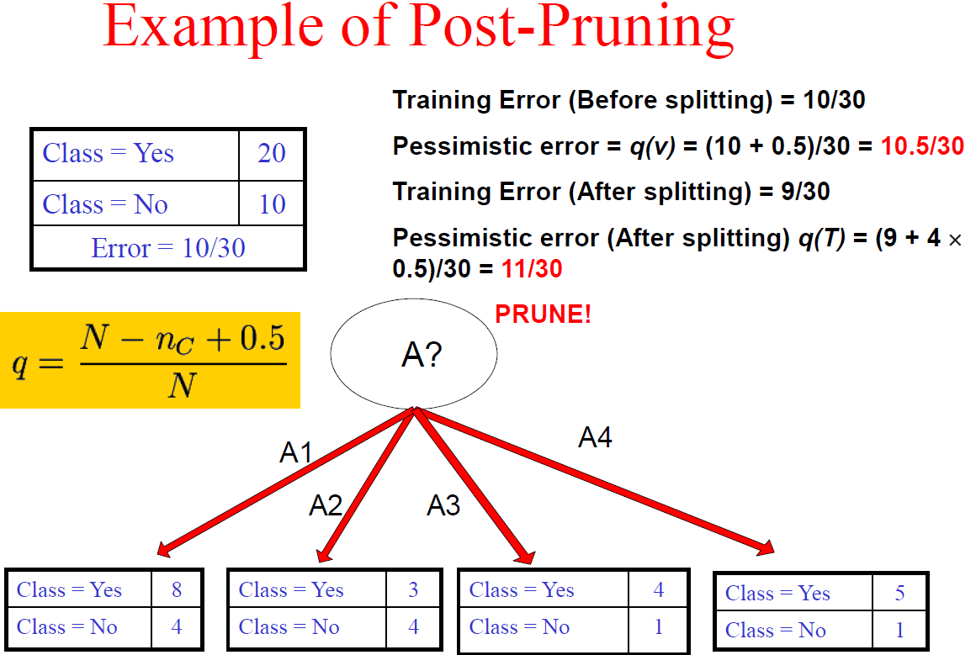
Approaches to Avoid Overfitting and Determine the Final Tree Size
?
?
Notes:
Error = 10/30 זו השגיאה אם נבצע סיווג על פי הרוב.

Slide 78
Approaches to Avoid Overfitting and Determine the Final Tree Size
Notes:
Error = 10/30 זו השגיאה אם נבצע סיווג על פי הרוב.

Slide 79
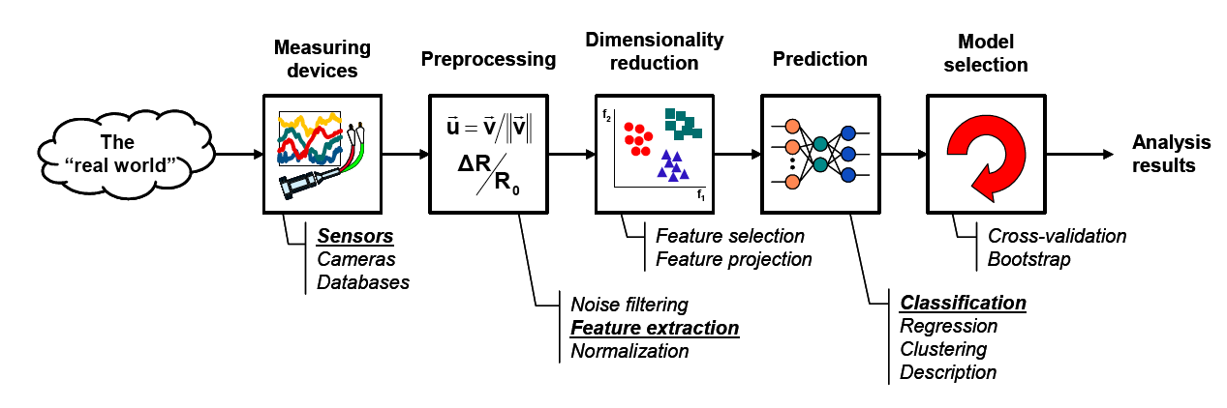
The learning process

